Slide 1
Soil Mechanics
Instructor:
M.M.Ahmadi

Slide 2
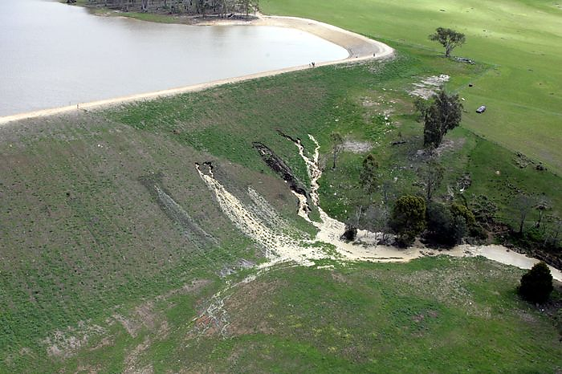
Seepage
Chapter 8

Slide 3
Seepage
Laplace’s Equation of Continuity
Continuity Equation for Solution of Simple Flow Problems
Flow Nets
Seepage Calculation from a Flow Net
Flow Nets in Anisotropic Soil
Mathematical Solution for Seepage
Uplift Pressure Under Hydraulic Structures
Seepage Through an Earth Dam on an Impervious Base
L. Casagrande’s Solution for SeepageThrough an Earth Dam
Filter Design

Slide 4
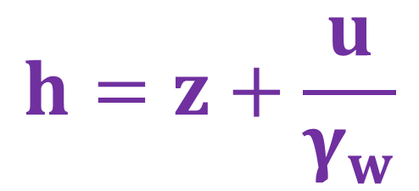
Calculation of Head
Bernoulli's Equation
For Seepage through soil:
Piezometric head (m)
Pore Water Pressure (kPa)
$$h=z+\frac{u}{γ_{w}}$$

Slide 5
Calculation of Head
Total Head Loss, h in water seeping from A to B:
In terms of Bernouli:
Hydraulic Gradient (Slope), i:
hydraulic grade line
h
h_{A}
A
h_{B}
B
z_{A}
L
z_{B}
∇
datum

Slide 6
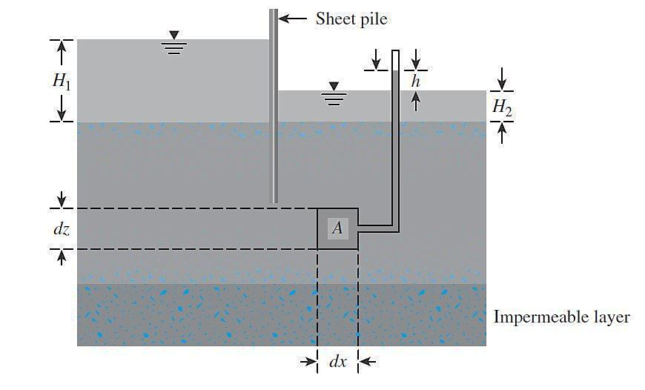
Laplace’s Equation of Continuity

Slide 7
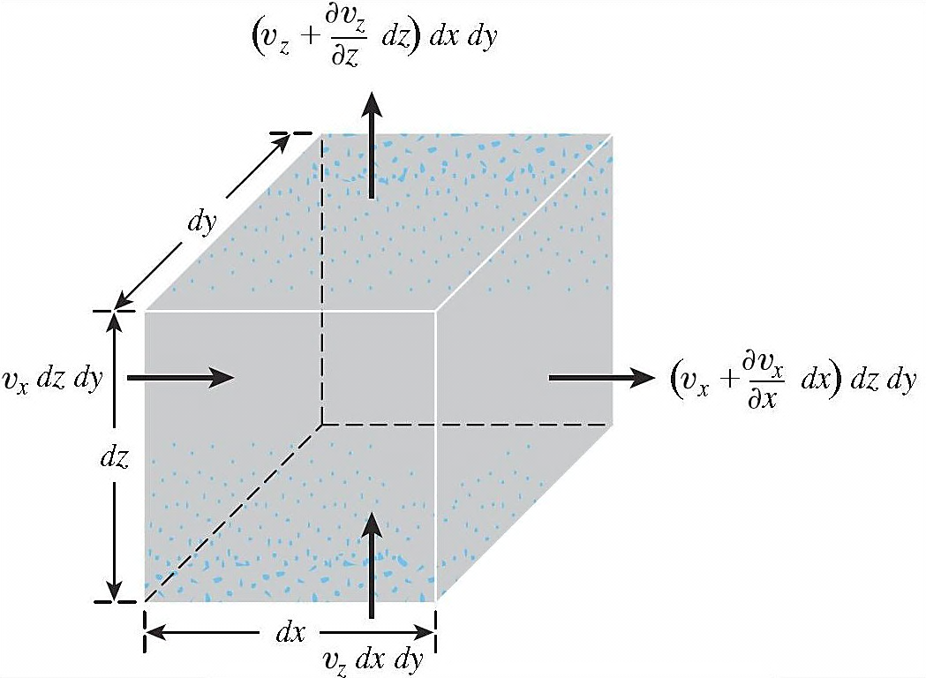
Laplace’s Equation of Continuity

Slide 8
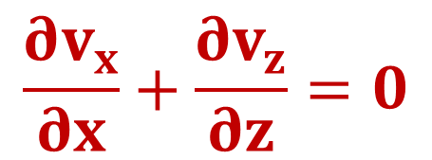
Laplace’s Equation of Continuity
Assuming that water is incompressible and that no volume change in the soil mass occurs, we know that the total rate of inflow should equal the total rate of outflow. Thus:
$$\left[\left(v_{x}+\frac{∂v_{x}}{∂x}dx\right)dzdy+\left(v_{z}+\frac{∂v_{z}}{∂z}dz\right)dxdy\right]−\left[v_{x}dzdy+v_{z}dxdy\right]=0$$
$$\frac{∂v_{x}}{∂x}+\frac{∂v_{z}}{∂z}=0$$

Slide 9
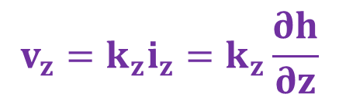

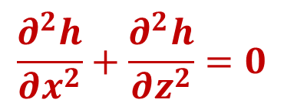
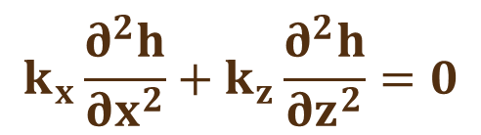
Laplace’s Equation of Continuity
According to Darcy’s law:
$$v_{x}=k_{x}i_{x}=k_{x}\frac{∂h}{∂x}$$
$$v_{z}=k_{z}i_{z}=k_{z}\frac{∂h}{∂z}$$
So we can write :
$$k_{x}\frac{∂^{2}h}{∂x^{2}}+k_{z}\frac{∂^{2}h}{∂z^{2}}=0$$
For isotropic soil: k_{x}= k_{z}
$$\frac{∂^{2}h}{∂x^{2}}+\frac{∂^{2}h}{∂z^{2}}=0$$

Slide 10
Solutions for Laplace’s Equation of Continuity
Analytical Solution
Finite Element
Finite Difference
Electrical Analogy
Flow Net

Slide 11
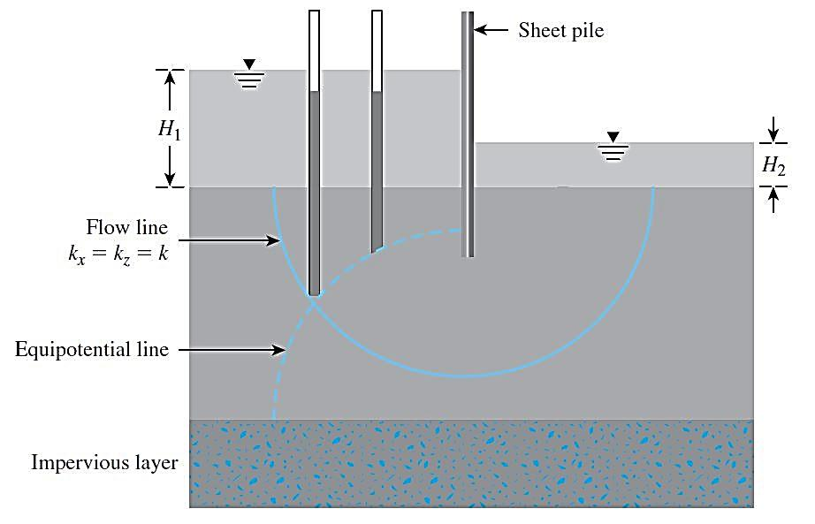
Flow Nets

Slide 12
Flow Nets
The equation for flow nets originates from Darcy’s Law.
Flow Net solution is equivalent to solving the governing equations of flow for a uniform isotropic aquifer with well-defined boundary conditions.

Slide 13
Flow Nets
The continuity equation in an isotropic medium represents two orthogonal families of curves—that is, the flow lines and the equipotential lines.
A flow line is a line along which a water particle will travel from upstream to the downstream side.
An equipotential line is a line along which the potential head at all points is equal.
A combination of a number of flow lines and equipotential lines is called a flow net.

Slide 14
Flow Nets
Flow nets are constructed for the calculation of groundwater flow and the evaluation of heads in the media.
To complete the graphic construction of a flow net :
1. The equipotential lines intersect the flow lines at right angles.
2. The flow elements formed are approximate squares.

Slide 15
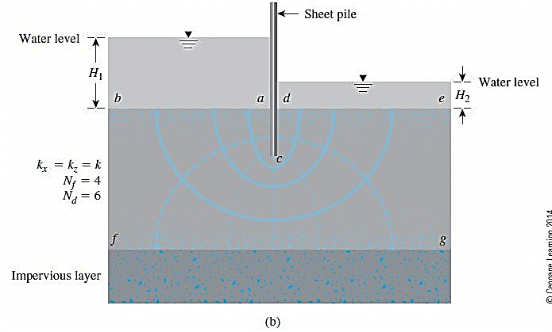
Flow Nets under a sheet pile
N_{f} = the number of flow channels in the flow net
N_{d} = the number of potential drops

Slide 16
Flow Nets
For the flow net under sheet pile, the following four boundary conditions apply:
Condition 1: The upstream and downstream surfaces of the permeable layer (lines ab and de) are equipotential lines.
Condition 2: Because ab and de are equipotential lines, all the flow lines intersect them at right angles.
Condition 3: The boundary of the impervious layer—that is, line fg—is a flow line, and so is the surface of the impervious sheet pile, line acd.
Condition 4: The equipotential lines intersect acd and fg lines at right angles.

Slide 17
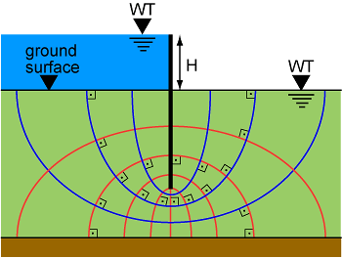
Flow Nets under a sheet pile

Slide 18
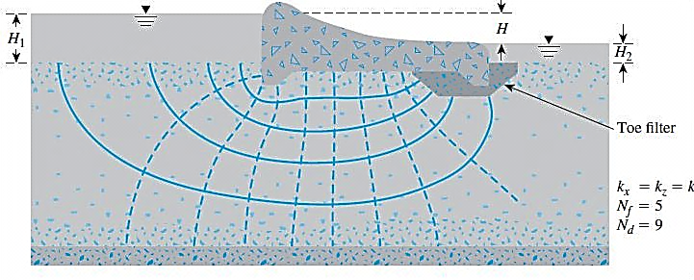
Flow Nets under a dam with toe filter

Slide 19
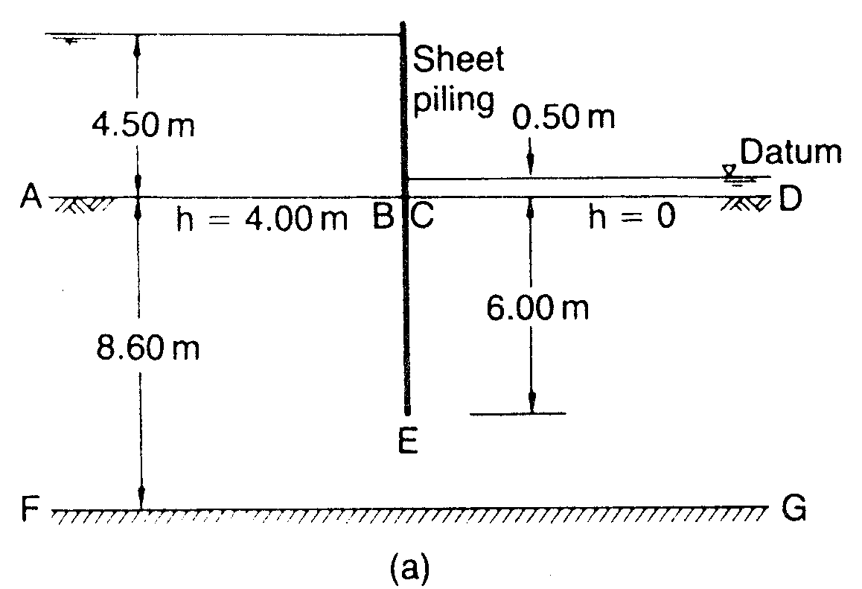
To construct a flow net, you must start with a scale drawing of the hydraulic structure:
Downstream Equipotential Boundary
Upstream Equipotential Boundary
1. Draw Flow Channel Boundaries
2. Draw Equipotential Boundaries
19

Slide 20
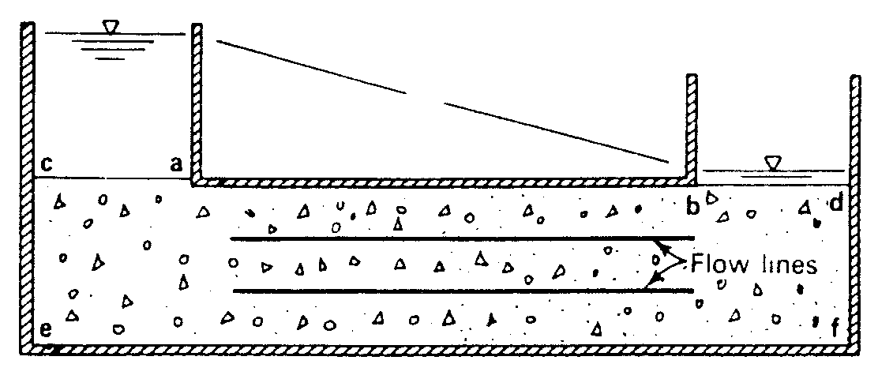


Drawing Flow Nets
If we divide the seepage journey into equally spaced drops in head then we get a flow net.
half way mark
h = h
h = 0.5h
x
h = 0
y
z

Slide 21
Flow Nets under a sheet pile
sand
bedrock

Slide 22
Flow Nets under a sheet pile
sand
bedrock

Slide 23
Flow Nets under a sheet pile
sand
bedrock

Slide 24
Flow Nets under a sheet pile
sand
bedrock

Slide 25
Flow Nets under dam
Reservoir
Tail water
soild
bedrock

Slide 26
Flow Nets under dam
Reservoir
Tail water
soild
bedrock

Slide 27
Flow Nets under dam
Reservoir
Tail water
soil
bedrock

Slide 28
Flow Nets under dam
Reservoir
soil
bedeock

Slide 29
Flow Nets under dam
Reservoir
soil
bedeock

Slide 30
Flow Nets under dam
Reservoir
soil
bedrock

Slide 31
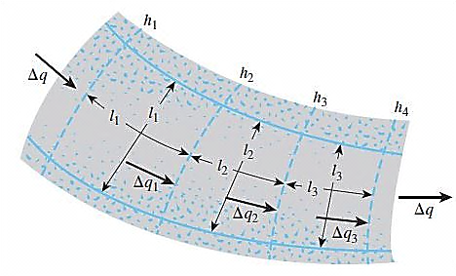
Seepage Calculation from a Flow Net
In any flow net, the strip between any two adjacent flow lines is called a flow channel.

Slide 32
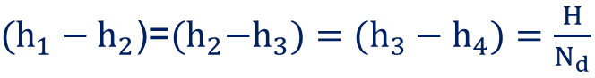
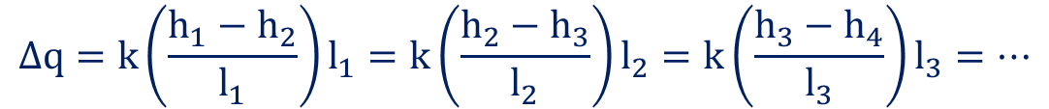
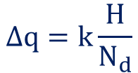
Seepage Calculation from a Flow Net
From Darcy’s law :
Thus,
And
$$∆q=k\left(\frac{h_{1}−h_{2}}{l_{1}}\right)l_{1}=k\left(\frac{h_{2}−h_{3}}{l_{2}}\right)l_{2}=k\left(\frac{h_{3}−h_{4}}{l_{3}}\right)l_{3}=…$$
$(h_{1}−h_{2}$)=${(h}_{2}−h_{3})=(h_{3}−h_{4})=\frac{H}{N_{d}}$
where H =head difference between the upstream and downstream sides
Nd =number of potential drops
$$∆q=k\frac{H}{N_{d}}$$

Slide 33
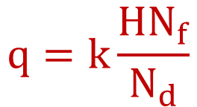
Seepage Calculation from a Flow Net
If the number of flow channels in a flow net is equal to Nf, the total rate of flow through all the channels per unit length can be given by :
Although drawing square elements for a flow net is convenient, it is not always necessary. Alternatively, one can draw a rectangular mesh for a flow channel, provided that the width-to-length ratios for all the rectangular elements in the flow net are the same
$$q=k\frac{HN_{f}}{N_{d}}$$

Slide 34
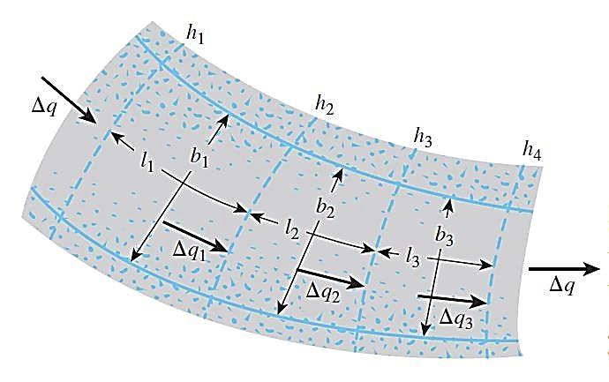
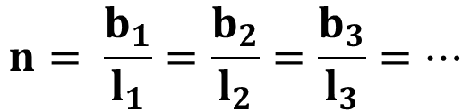
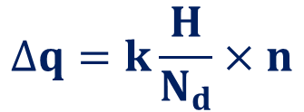
Seepage Calculation from a Flow Net
$$∆q=k\frac{H}{N_{d}}×n$$
In this case,
$$n= \frac{b_{1}}{l_{1}}=\frac{b_{2}}{l_{2}}=\frac{b_{3}}{l_{3}}=…$$

Slide 35
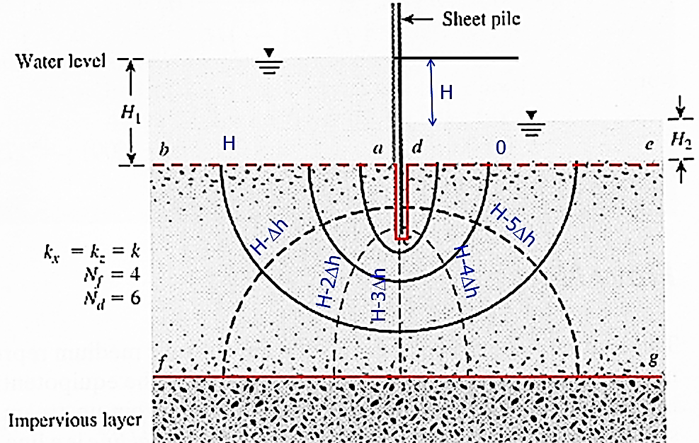
Head drop in flow net

Slide 36
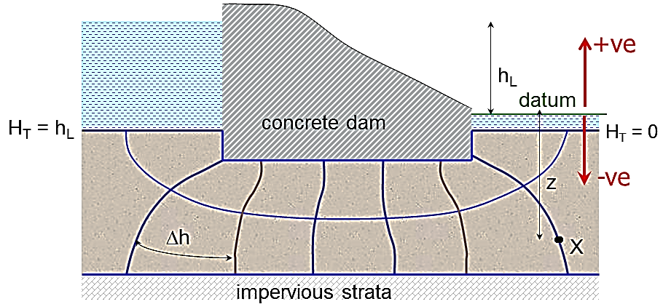
Pressure head at any point
Total head=h_{L} - numbers of drops from upstream x Δh
Pressure head = Total head – Elevation head
Elevation head = z (-ve number in this figure)

Slide 37
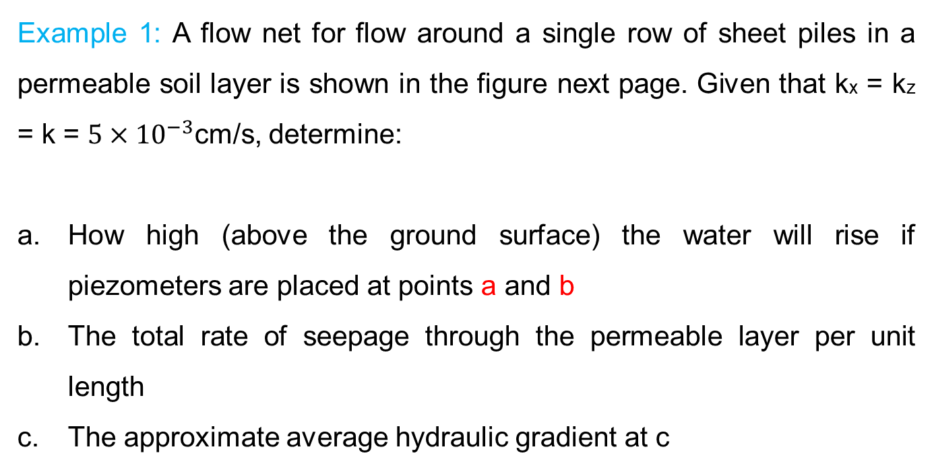
Seepage Calculation from a Flow Net
Example 1: A flow net for flow around a single row of sheet piles in a permeable soil layer is shown in the figure next page. Given that kx = kz = k = $5×{10}^{−3}$cm/s, determine:
How high (above the ground surface) the water will rise if piezometers are placed at points a and b
The total rate of seepage through the permeable layer per unit length
The approximate average hydraulic gradient at c

Slide 38
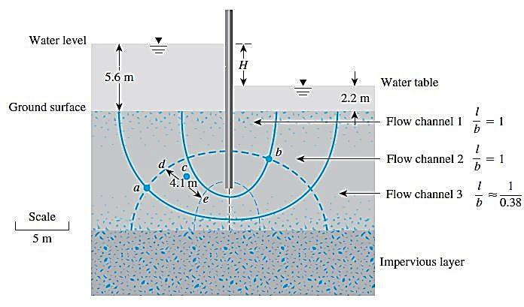
Seepage Calculation from a Flow Net
Example 1

Slide 39
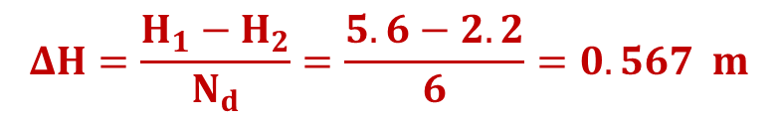
Seepage Calculation from a Flow Net
Part a :
we have Nd = 6, H1 = 5.6 m, and H2 = 2.2 m. So the head loss of each potential drop is :
$$ΔH=\frac{H_{1}−H_{2}}{N_{d}}=\frac{5.6−2.2}{6}=0.567 m$$
At point a, we have gone through one potential drop. So the water in the piezometer will rise to an elevation of (5.6 - 0.5672) = 5.033 m above the ground surface
At point b, we have five potential drops. So the water in the piezometer will rise to an elevation of (5.6-5(0.567))= 2.765 m above the ground surface

Slide 40
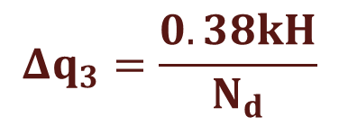
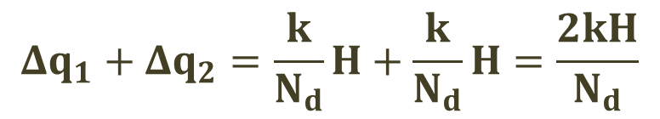
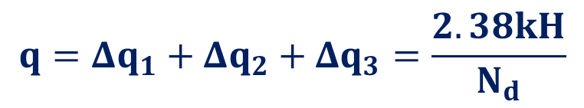
Seepage Calculation from a Flow Net
Part b :
Flow channel 3 has rectangular elements. These elements have a width-to-length ratio of about 0.38; hence,
So, the total rate of seepage can be given as:
$$Δq_{1}+Δq_{2}=\frac{k}{N_{d}}H+\frac{k}{N_{d}}H=\frac{2kH}{N_{d}}$$
$$Δq_{3}=\frac{0.38kH}{N_{d}}$$
$$q=Δq_{1}+Δq_{2}+Δq_{3}=\frac{2.38kH}{N_{d}}$$

Slide 41
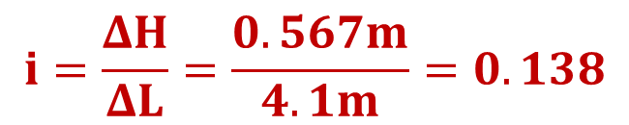
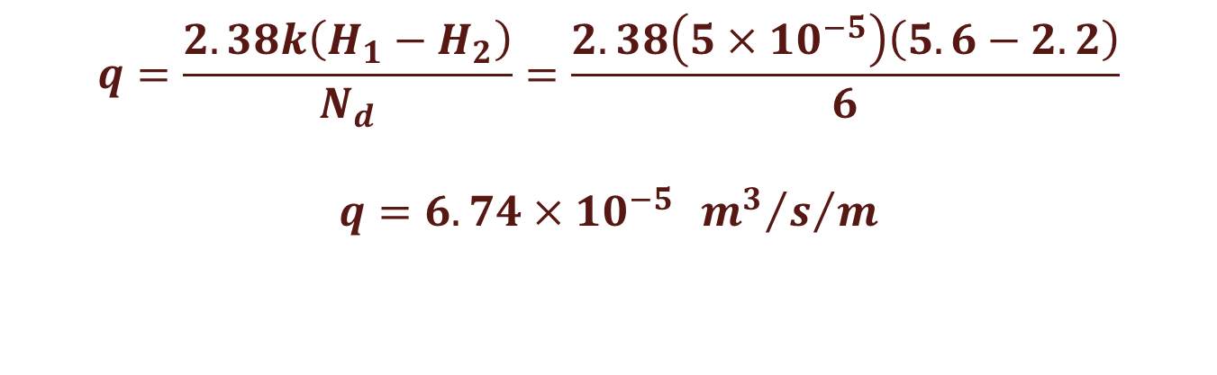
Seepage Calculation from a Flow Net
$$q=\frac{2.38k\left(H_{1}−H_{2}\right)}{N_{d}}=\frac{2.38\left(5×{10}^{−5}\right)\left(5.6−2.2\right)}{6}$$
$$q=6.74×{10}^{−5}{{{ m}^{3}}/s}/m$$
Part c : The average hydraulic gradient at c can be given as :
$$i=\frac{ΔH}{ΔL}=\frac{0.567m}{4.1m}=0.138$$

Slide 42
Multiple choice question 1:If k = 10⁻⁷ m/s, what would be the flow per day over a 100 m length of wall?
A. 7 m³/day
B. 14 m³/day
C. 28 m³/day
D. 35 m³/day

Slide 43
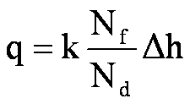
solution:
N_{f} = 5
N_{d} = 14
Δh = 45 m
k = 10⁻⁷ m/s
q = 10⁻⁷(5/14) 45 x 100 m length
q = 0.000161 m³/s
q = 13.9 m³/day

Slide 44
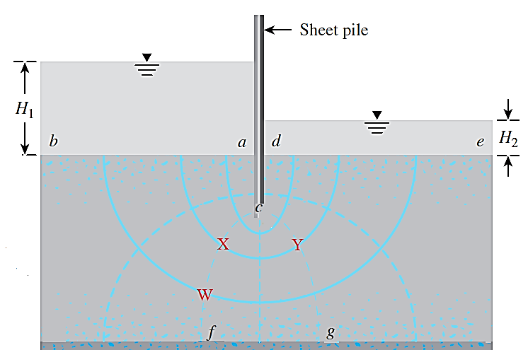
Multiple choice question 2: According to this figure, which one of these choices is correct?
A. h_{X} = h_{Y} > h_{W}
B. h_{X} > h_{Y} > h_{W}
C. h_{X} = h_{W} > h_{Y}
D. h_{X} > h_{W} > h_{Y}
Solution:
X & W are located in the same equipotential line (cf Line)
h_{X} = h_{W}
Head at cf Line = H-2Δh
h_{X} > h_{Y}
Head at cg Line = H-4Δh

Slide 45
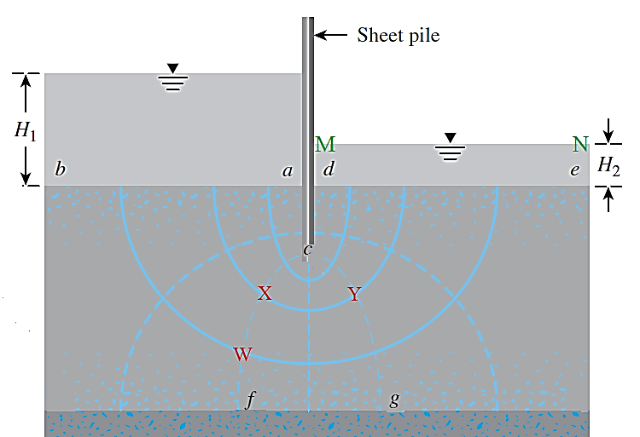
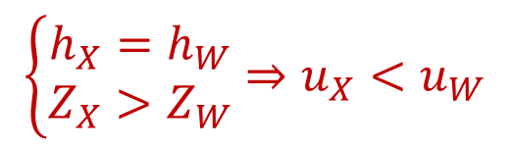
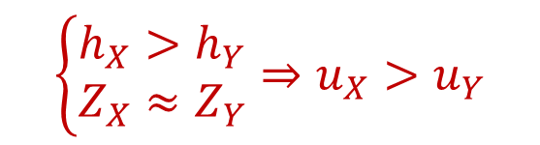
Multiple choice question 3: According to this figure, which one of these choices is correct?
A. u_{X} = u_{Y}
B. u_{X} < u_{Y}
C. u_{X} = u_{W}
D. u_{X} < u_{W}
Solution:
Consider MN Line as Datum
$$\left\{\begin{matrix}h_{X}>h_{Y} \\ Z_{X}≈Z_{Y}\end{matrix}\right.⇒u_{X}>u_{Y}$$
$$\left\{\begin{matrix}h_{X}=h_{W} \\ Z_{X}>Z_{W}\end{matrix}\right.⇒u_{X}<u_{W}$$

Slide 46
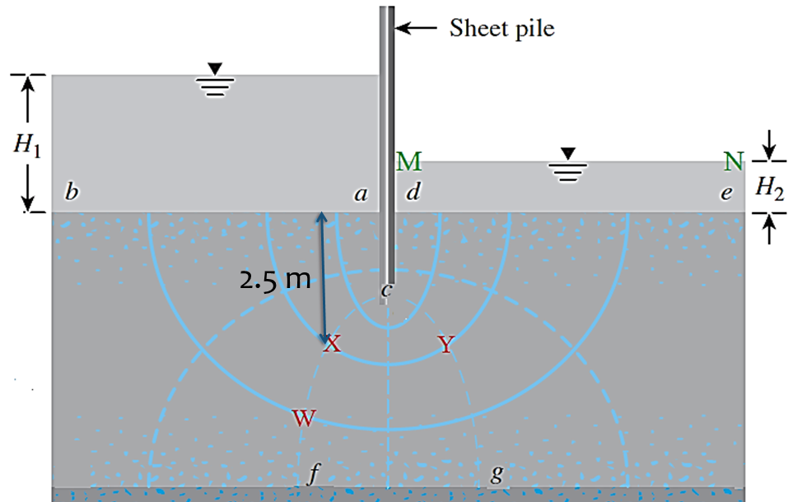
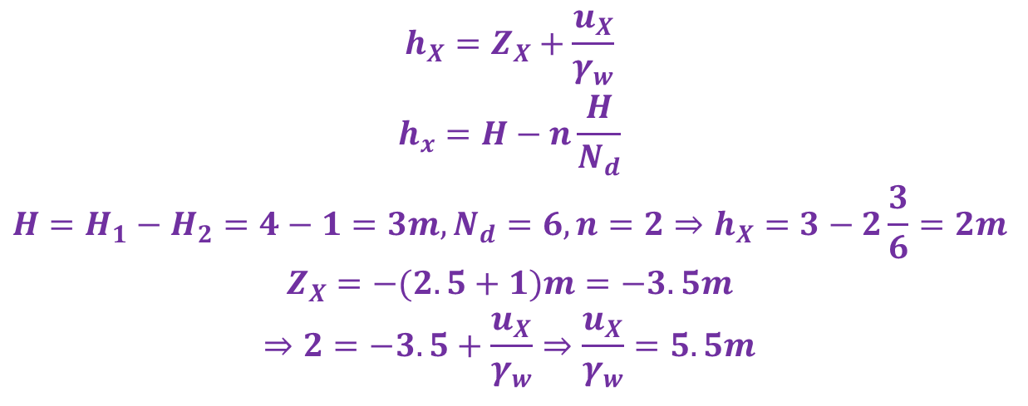
Multiple choice question 4: According to this figure, if MN Line is considered as datum, H₁=4m and H₂=1m, the pressure head at point X is:
A. 3.0m B. 4.5m
C. 5.5m D. 6.0m
Solution
$$\begin{matrix}h_{X}=Z_{X}+\frac{u_{X}}{γ_{w}} \\ h_{x}=H−n\frac{H}{N_{d}} \\ H=H_{1}−H_{2}=4−1=3m,N_{d}=6,n=2⇒h_{X}=3−2\frac{3}{6}=2m \\ Z_{X}=−(2.5+1)m=−3.5m \\ ⇒2=−3.5+\frac{u_{X}}{γ_{w}}⇒\frac{u_{X}}{γ_{w}}=5.5m\end{matrix}$$

Slide 47
Flow Nets in Anisotropic Soil
Step 1: Adopt a vertical scale (that is, z axis) for drawing the cross section.
Step 2: Adopt a horizontal scale (that is, x axis) such that :
horizontal scale =
vertical scale.
Step 3: With scales adopted as in Steps 1 and 2, plot the vertical section through the permeable layer parallel to the direction of flow.
Step 4: Draw the flow net for the permeable layer on the section obtained from Step 3, with flow lines intersecting equipotential lines at right angles and the elements as approximate squares.

Slide 48
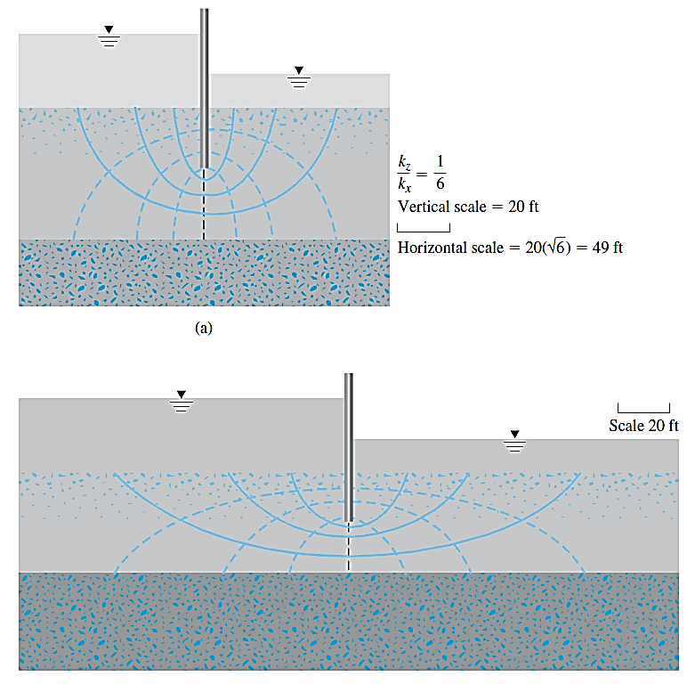
Flow Nets in Anisotropic Soil
A flow element in anisotropic soil:
(a) in transformed section;
(b) in true section

Slide 49
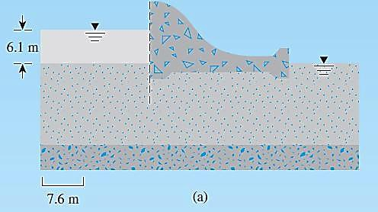
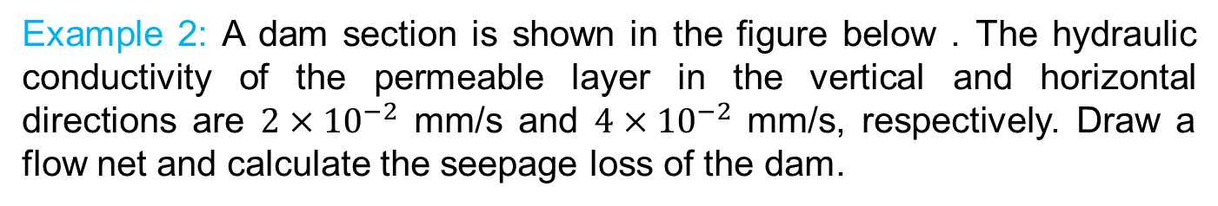
Flow Nets in Anisotropic Soil
Example 2: A dam section is shown in the figure below . The hydraulic conductivity of the permeable layer in the vertical and horizontal directions are $2×{10}^{−2}$ mm/s and $4×{10}^{−2}$ mm/s, respectively. Draw a flow net and calculate the seepage loss of the dam.

Slide 50
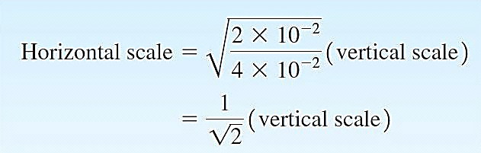
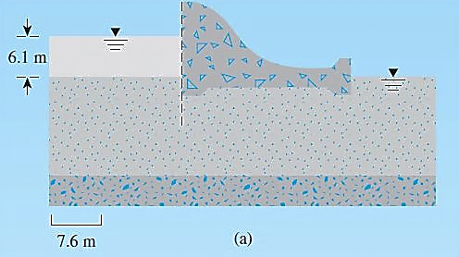
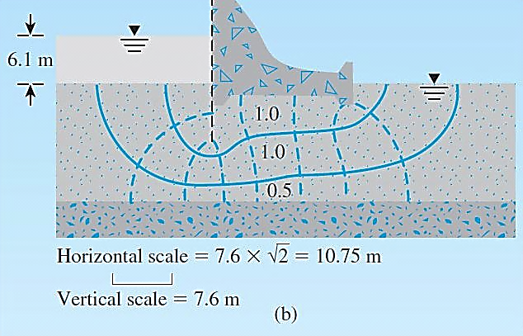
Flow Nets in Anisotropic Soil

Slide 51
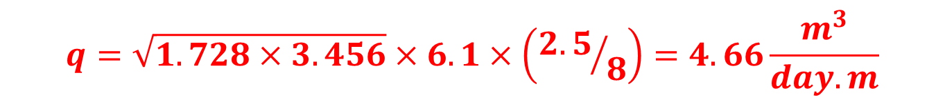
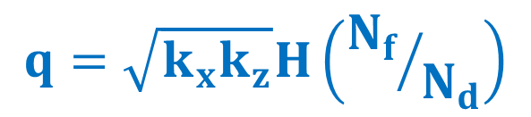
Flow Nets in Anisotropic Soil
The rate of seepage is given by:
$$q=\sqrt{k_{x}k_{z}}H\left({N_{f}}/{N_{d}}\right)$$
From Scaled Figure, Nd=8 and Nf = 2.5 (the lowermost flow channel has a width-to-length ratio of 0.5). So,
$$q=\sqrt{1.728×3.456}×6.1×\left({2.5}/8\right)=4.66\frac{m^{3}}{day.m}$$

Slide 52
Mathematical Solution for Seepage
The seepage under several simple hydraulic structures can be solved mathematically. Harr (1962) has analyzed many such conditions.
The following graph shows a non-dimensional plot for the rate of seepage around a single row of sheet piles.

Slide 53
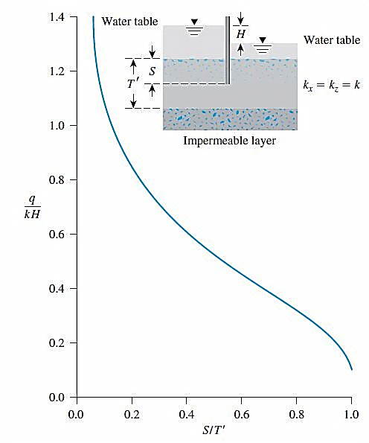
Mathematical Solution for Seepage

Slide 54
Mathematical Solution for Seepage
In a similar manner, the following graph is a non-dimensional plot for the rate of seepage under a dam. The depth of penetration of the sheet pile is S, and the thickness of the permeable soil layer is T.

Slide 55
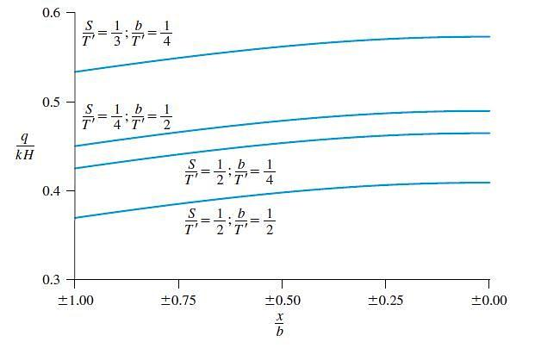
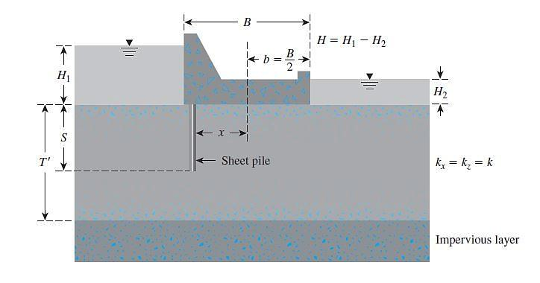
Mathematical Solution for Seepage

Slide 56

Mathematical Solution for Seepage
Example 3:
Given; the width of the dam, B =6 m; length of the dam, L =120 m; S =3 m; $\acute{T}$=6 m; x =2.4 m; and H₁ - H₂ = 5 m. If the hydraulic conductivity of the permeable layer is 0.008 cm/s, estimate the seepage under the dam (Q) in m³/day.

Slide 57
Mathematical Solution for Seepage
Example 3:

Slide 58



Mathematical Solution for Seepage
$$\frac{b}{T^{′}}=\frac{3}{6}=0.5$$
$$\frac{S}{T^{′}}=\frac{3}{6}=0.5$$
$$\frac{x}{b}=\frac{2.4}{3}=0.8$$

Slide 59





Mathematical Solution for Seepage
$$\frac{b}{T^{′}}=\frac{3}{6}=0.5$$
$$\frac{S}{T^{′}}=\frac{3}{6}=0.5$$
$$\frac{q}{kH}≈0.378$$
$$\frac{x}{b}=\frac{2.4}{3}=0.8$$
$$Q=qL=0.378kHL$$
$$Q=0.378\left(0.008×{10}^{−2}×60×60×24\right)\left(5\right)\left(120\right)$$
$$Q≈1567{{ m}^{3}}/day$$

Slide 60

Heads at a Point X
Total head = h - # of drops from upstream x Δh
Elevation head = z (-ve number in this figure)
Pressure head = Total head – Elevation head
h
datum
H = h
concrete dam
z
Δh
X
impervious strata

Slide 61

Uplift Pressure under Hydraulic Structures
The pressure distribution diagram at the base can be obtained from the equipotential lines as follows.
The head loss for
each potential drop is :
Uplift pressure at point a (left corner of the base) = (Pressure head at point a) ₓ (γ_{w} )
= [(7+2)-1] γ_{w}=8 γ_{w}

Slide 62
Uplift Pressure Under Hydraulic Structures
Uplift pressure at point b = (Pressure head at point b) ₓ (γ_{w} ) = [9-2*1] γ_{w}=7 γ_{w}
Uplift pressure at point f = (Pressure head at point f) ₓ (γ_{w} ) = [9-6*1] γ_{w}=3 γ_{w}

Slide 63



Multiple choice question 6: According to this figure, if h₁=6m, H₁=2m, H₂=1m, k₁=10⁻⁴cm/s and k₂=5x10⁻⁵cm/s, the pressure head at AB Line (h₂) is:
A. 4m B. 3m
C. 2m D. 1m
Solution
$$q=kiA=k\left(\frac{Δh}{L}\right)A$$
$$q_{1}=q_{2}⇒{10}^{−4}×\frac{Δh_{1}}{2}×A=5×{10}^{−5}×\frac{Δh_{2}}{1}×A$$
$Δh_{1}=Δh_{2}⇒Δh_{1}=3 m$ $⇒h=6−3=3 m$

Slide 64

Dam failure due to seepage

Slide 65

Dam failure due to seepage

Slide 66

Example of dam failure due to seepage: Baldwin Hills dam broke in 1963 due to seepage.

Slide 67


Example of dam failure due to seepage: Baldwin Hills dam broke in 1963 due to seepage.

Slide 68

Example of dam failure due to seepage: Baldwin Hills dam broke in 1963 due to seepage.

Slide 69

Example of dam failure due to seepage: Baldwin Hills dam broke in 1963 due to seepage.

Slide 70


Example of dam failure due to seepage: Fontenelle dam broke in 1965 due to seepage.

Slide 71

Example of dam failure due to seepage: Around 7:00 am on June 5, 1976 a leak about 30 m from the top of Teton dam was observed.

Slide 72

Example of dam failure due to seepage: Teton dam Dam broke at 11:59 AM

Slide 73

Seepage Through an Earth Dam on an Impervious Base

Slide 74





Seepage Through an Earth Dam on an Impervious Base
The slope of the free surface can be assumed to be equal to the hydraulic gradient . It is also assumed that this hydraulic gradient is constant with depth :
Considering the triangle cde :
So :
$$i≈\frac{dz}{dx}$$
$$q=kiA$$
$$i=\frac{dz}{dx}=tan⁡(α)$$
$$A=\overline{ce}=L sin⁡(α)$$
$$q=kLsin\left(α\right)\tan\left(α\right) (1)$$

Slide 75



Seepage Through an Earth Dam on an Impervious Base
Again, the rate of seepage (per unit length of the dam) through the section bf :
For continuous flow :
By integrating the following equation we have :
$$q=kiA=k\frac{dz}{dx}(z×1)$$
$$q_{ce}=q_{bf}→kz\frac{dz}{dx}=kLsin\left(α\right)tan⁡(α)$$
$$\int_{z=Lsinα}^{z=H}{kz dz = \int_{x=Lcos(α)}^{x=d}{kLsin\left(α\right)tan⁡(α) dx}}$$

Slide 76


Seepage Through an Earth Dam on an Impervious Base
By doing some mathematical calculation :
Step to find seepage rate :
Step 1: Obtain $α$.
Step 2: Calculate $∆$ and then $0.3∆ .$
Step 3: Calculate d.
Step 4: With known values of $α$and d, calculate L from Eq.2 .
Step 5: With known value of L, calculate q from Eq.1.
$$L=\frac{d}{cosα}−\sqrt{\frac{d^{2}}{\cos^{2}α}−\frac{H^{2}}{\sin^{2}α} (2)}$$

Slide 77


Seepage Through an Earth Dam on an Impervious Base
Example 5 : Refer to the earth dam shown in the figure below. Given that $β=45°, α=30°$, B = 3 m, H = 6 m, height of dam = 7.6 m, and k$=61×{10}^{−6}$ m/min, calculate the seepage rate, q.

Slide 78




Seepage Through an Earth Dam on an Impervious Base

Slide 79

L. Casagrande’s Solution for Seepage through an Earth Dam
Also a graphical solution was provided by
Gilboy (1934) :

Slide 80

L. Casagrande’s Solution for Seepage through an Earth Dam
In order to use the graph :
Step 1: Determine d/H.
Step 2: For a given d/H and $α,$ determine m.
Step 3: Calculate $L=\frac{mH}{sinα}$.
Step 4: Calculate $kL\sin^{2}α$.

Slide 81
Drawing Flow Nets

Slide 82
Multiple choice question 5: An atmospheric line is defined as a line within a dam section below which there are:
A. positive hydrostatic pressures
B. positive equipotential lines
C. negative hydrostatic pressures
D. negative equipotential lines

Slide 83
Filter Design
For proper selection of the filter material, two conditions should be kept in mind:
Condition 1: The size of the voids in the filter material should be small enough to hold the larger particles of the protected material in place.
We call this condition, Retention Criteria.
Condition 2: The filter material should have a high hydraulic conductivity to prevent buildup of large seepage forces and hydrostatic pressures in the filters.
We call this condition Permeability Criteria.

Slide 84
Filter Design
When seepage water flows from a soil with relatively fine grains into a coarser material, there is danger that the fine soil particles may wash away into the coarse material.
Over a period of time, this process may clog the void spaces in the coarser material. Hence, the grain-size distribution of the coarse material should be properly manipulated to avoid this situation.
granular filter
A properly designed coarser material is called a filter

Slide 85

Filter Design
It can be shown that, if three perfect spheres have diameters greater than 6.5 times the diameter of a smaller sphere, the small sphere can move through the void spaces of the larger ones.

Slide 86

Filter Design
If the pore spaces in a filter are small enough to hold D₈₅ of the soil to be protected, then the finer soil particles also will be protected This means that the effective diameter of the pore spaces in the filter should be less than D₈₅ of the soil to be protected.

Slide 87


Filter Design
The effective pore diameter is about $\frac{1}{5}D_{15}$of the filter. With this in mind and based on the experimental investigation of filters, Terzaghi and Peck (1948) provided the following criteria to satisfy Condition 1:

Slide 88


Filter Design
In order to satisfy Condition 2, they suggested that :

Slide 89

Filter Design
The proper use of the equations to determine the grain-size distribution of soils used as filters is shown.

Slide 90



Filter Design
The U.S. Navy (1971) requires the following conditions for the design of filters.
Condition 1: For avoiding the movement of the particles of the protected soil:
$$\frac{D_{\left.15(F\right)}}{D_{\left.85(S\right)}}≤5$$
$$\frac{D_{\left.50(F\right)}}{D_{\left.50(S\right)}}≤25$$
$$\frac{D_{\left.15(F\right)}}{D_{\left.15(S\right)}}≤20$$

Slide 91

Filter Design
Condition 2: For avoiding buildup of large seepage force in the filter:
Condition 3: The filter material should not have grain sizes greater than 76.2 mm (3 in.). (This is to avoid segregation of particles in the filter.)
$$\frac{D_{\left.15(F\right)}}{D_{\left.15(S\right)}}≥4$$

Slide 92

Filter Design
Condition 4: To avoid internal movement of fines in the filter, it should have no more than 5% passing a No. 200 sieve.
Condition 5: When perforated pipes are used for collecting seepage water, filters also are used around the pipes to protect the fine-grained soil from being washed into the pipes. To avoid the movement of the filter material into the drain-pipe perforations, the following additional conditions should be met:

Slide 93
Summary of Filter Design
Terzaghi & Peck (1967)
US Navy (1971)
Retention criteria:
D_{15, filter} < 20 D_{15, soil}
D_{15, filter} < 5 D_{85, soil}
D_{50, filter} < 25 D_{50, soil}
average filter pore size
Permeability criteria:
D_{15, filter} > 4 D_{15, soil}

Slide 94
Multiple choice question 7: Based on Terzaghi & Peck criteria for filter design, which one of these choices is correct?
A. D_{15,filter} > D_{85,soil}
B. D_{15,filter} < D_{15,soil}
C. D_{15,filter} < 5D_{85,soil}
D. D_{15,filter} > 5D_{85,soil}

Slide 95
Multiple choice question 8: Based on Terzaghi & Peck criteria for filter design, For avoiding buildup of large seepage force in the filter we must have:
A. D_{15,filter} > 4D_{15,soil}
B. D_{15,filter} > 4D_{85,soil}
C. D_{15,filter} < 4D_{15,soil}
D. D_{15,filter} < 4D_{85,soil}

